Slide 1
PAGING AND SEGMENTATION
Basic Definition of Paging
Physical memory is divided into fixed sized-blocks called frames.
Logical memory is divided into blocks of the same size called pages
A frame
has the same size as a page
is a place where a page can be placed.

Slide 2
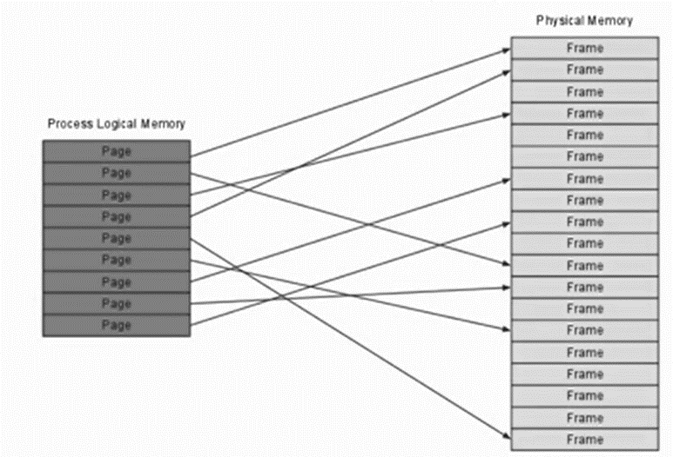
Address Mapping

Slide 3
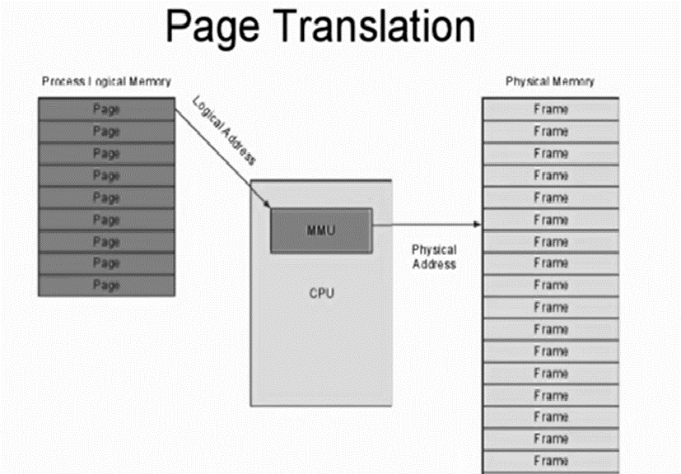

Slide 4
Paging Hardware
Every address generated by the CPU is divided into two parts: Page number (p) and Page offset (d)
Page number (p) – used as an index into a page table which contains base address of each page in physical memory.
Page offset (d) – combined with base address to define the physical memory address that is sent to the memory.

Slide 5
Paging Hardware
The page number is used as an index into a Page Table
The page size is defined by the hardware
The size of a page is typically a power of 2, varying between
bytes and 16MB per page
Reason: If the size of logical address is 2^m and page size is 2^n, then the high-order
m-n bits of a logical address designate the page number

Slide 6
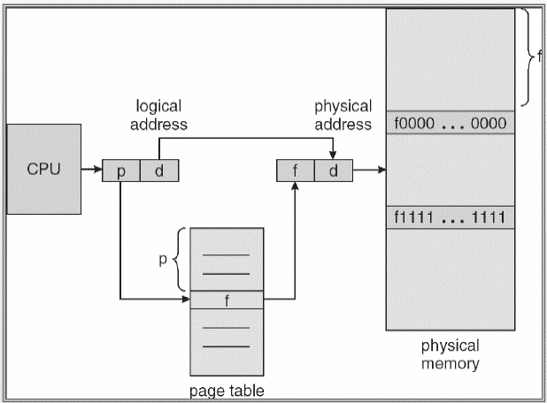
Paging Hardware

Slide 7
Paging Example
When we use a paging scheme, we have no external fragmentation: ANY free frame can be allocated to a process that needs it.
However, we may have internal fragmentation
If the process requires n pages, at least n frames are required
The first page of the process is loaded into the first frame listed on free-frame list, and the frame number is put into page table

Slide 8
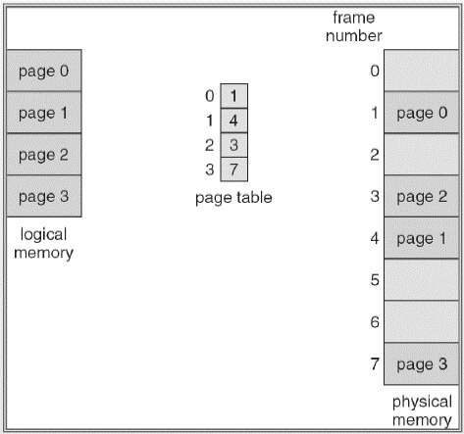
Paging Example

Slide 9
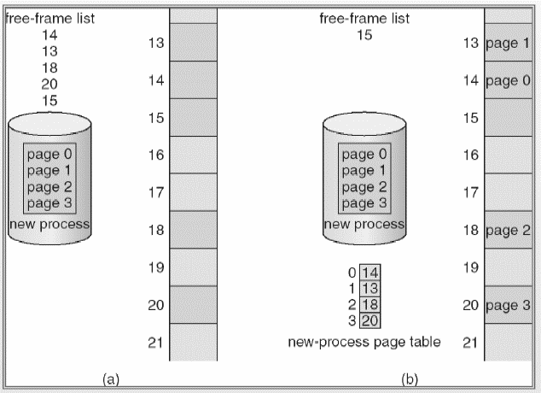
Paging Example

Slide 10
Implementing Page Table
To implement paging, the simplest method is to implement the page table as a set of registers
However, the size of register is limited and the size of page table is usually large
Therefore, the page table is kept in main memory

Slide 11
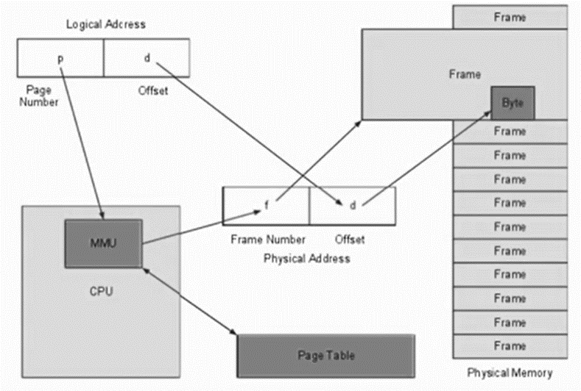
MMU Address Transaction

Slide 12
Implementing Paging
If we want to access any location, we must first index into the page table
This requires at least one memory access
The standard solution is to use a special, small, fast cache, called Translation look-aside buffer (TLB) or associative memory

Slide 13
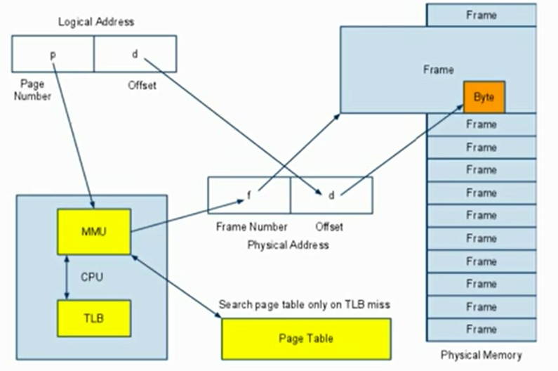
TLB-Assisted Transaction

Slide 14
TLB
If the page number is not in the TLB (TLB miss) a memory reference to the page table must be made.
In addition, we add the page number and frame number into TLB
If the TLB is already full, the OS have to select one for replacement
Some TLBs allow entries to be wire down, meaning that they cannot be removed from the TLB, for example kernel codes
The percentage of times that a particular page number is found in the TLB is called hit ratio

Slide 15
ADVANTAGES OF PAGING
No external Fragmentation
Simple memory management algorithm
Swapping is easy (Equal sized Pages and Page Frames)
Share common code especially in a time-sharing environment
DISADVANTAGES
Internal fragmentation
Page tables may consume more memory.
Multi level paging leads to memory reference overhead.

Slide 16
Segmentation
Although the user can refer to objects in the program by a two-dimensional address, the actual physical address is still a one-dimensional sequence
Thus, we need to map the segment number
This mapping is effected by a segment table
In order to protect the memory space, each entry in segment table has a segment base and a segment limit

Slide 17
Logical addressing in Segmentation
Logical Address space is divided into segment number and offset.
The mapping of the logical address to the physical address is done with the help of the segment table.
SEGMENT TABLE
Segment Limit | Segment Base | Other bits
Segment Limit- Is the length of the segment
Segment Base- Is the starting address of the corresponding segment in the main memory.
Other bits- A bit is needed to determine if the segment is already in main memory. Another bit is needed to determine if the segment has been modified since it was loaded into the main memory.

Slide 18
Segmentation
Segments are variable-sized
Dynamic memory allocation required (first fit, best fit, worst fit).
External fragmentation
In the worst case the largest hole may not be large enough to fit in a new segment. Note that paging has no external fragmentation problem.
Each process has its own segment table
like with paging where each process has its own page table. The size of the segment table is determined by the number of segments, whereas the size of the page table depends on the total amount of memory occupied.
Segment table located in main memory
as is the page table with paging
Segment table base register (STBR)
points to current segment table in memory
Segment table length register (STLR)
indicates number of segments

Slide 19
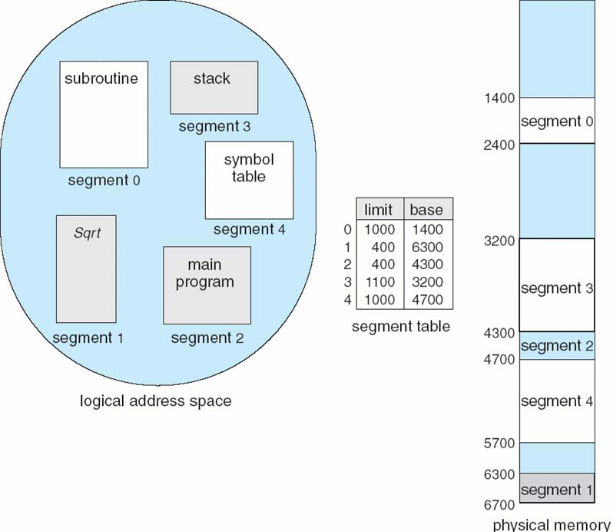
Example of Segmentation

Slide 20
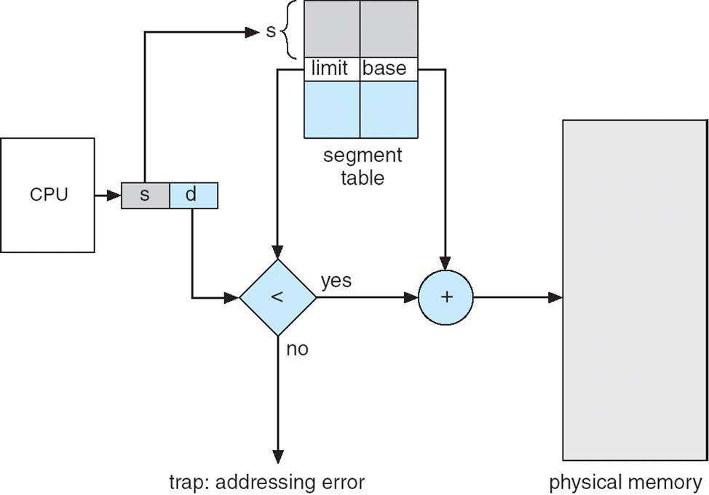
Segmentation Hardware

Slide 21
Protection and Sharing
Segmentation lends itself to the implementation of protection and sharing policies
Each entry has a base address and length so inadvertent memory access can be controlled
Sharing can be achieved by segments referencing multiple processes
Two processes that need to share access to a single segment would have the same segment name and address in their segment tables.

Slide 22
Advantages of Segmentation
No internal fragmentation
Segment tables consume less memory than page tables ( only one entry per actual segment as opposed to one entry per page in Paging method)
Because of the small segment table, memory reference is easy
Lends itself to sharing data among processes.
Lends itself to protection.
As the individual lines of a page do not form one logical unit, it is not possible to set a particular access right to a page.
Note that each segment could be set up an access right

Slide 23
Disadvantages of Segmentation
External fragmentation.
Costly memory management algorithm
Unequal size of segments is not good in the case of swapping.

Slide 24
Paging verses Segmentation
With paging physical memory is divided into fixed-size frames. When memory space is needed, as many free frames are occupied as necessary. These frames can be located anywhere in memory, the user process always sees a logical contiguous address space
With segmentation the memory is not systematically divided. When a program needs k segments (usually these have different sizes), the OS tries to place these segments in the available memory holes. The segments can be scattered around memory. The user process does not see a contiguous address space, but sees a collection of segments (of course each individual segment is contiguous as is each page or frame).

Slide 25
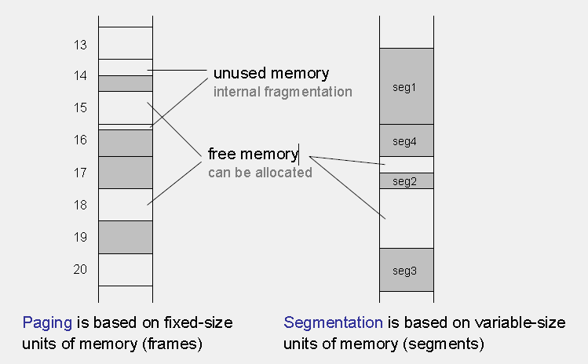
Paging verses Segmentation

Slide 26
Paging verses Segmentation
Paging
Segmentation
Each process is assigned its page table.
Page table size proportional to allocated memory
Often large page tables and/or multi-level paging
Internal fragmentation
Free memory is quickly allocated to a process
Each process is assigned a segment table
Segment table size proportional to number of segments
Usually small segment tables
External fragmentation.
Lengthy search times when allocating memory to a process.

